Slide 2

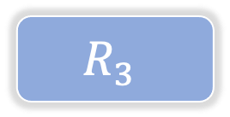



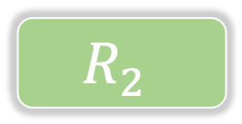



$$<$$
$$X_{3}$$
$$S_{1,1}$$
YES
NO
$$<$$
$$R_{3}$$
$$X_{1}$$
$$S_{2,1}$$
YES
NO
$$R_{1}$$
$$R_{2}$$

Slide 3

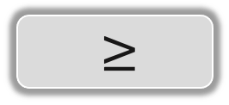
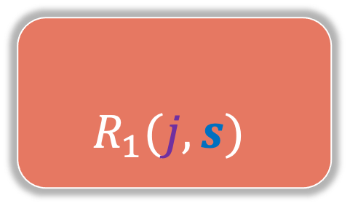








$$s∈ℝ$$
$$R_{1}(j, s)$$
$$R_{2}(j, s)$$
$$<$$
$$≥$$
$$X_{j}$$
$$S$$
$$X_{j}$$
$$S$$
$j=1 , …, p$,

Slide 4

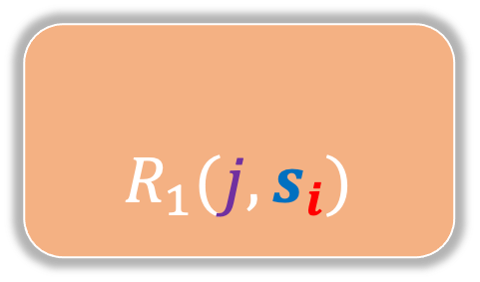



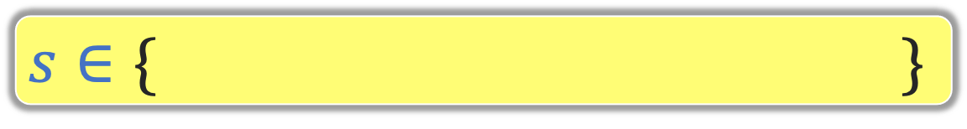


$$s∈\{ \}$$
$$s_{1}=x_{j,1}$$
$$s_{2}=x_{j,2}$$
$$⋯⋯⋯$$
$$s_{n}=x_{j,2}$$
$$R_{1}(j, s_{i})$$
$$R_{2}(j, s_{i})$$
$$<$$
$$≥$$
$$X_{j}$$
$$S$$
$$X_{j}$$
$$S$$
$j=1 , …, p$

Slide 5



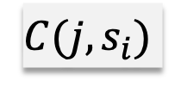


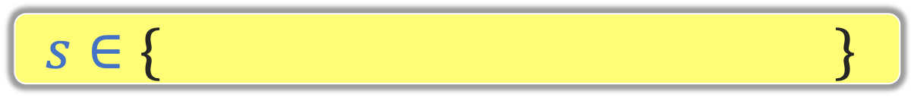

$$s∈\{ \}$$
$$s_{1}=x_{j,1}$$
$$s_{2}=x_{j,2}$$
$$⋯⋯⋯$$
$$s_{n}=x_{j,2}$$
i=1
i=2
i=n-1
i=n
j=1
$j=1 , …, p$
j=2
$$C(j,s_{i})$$
$$⋮$$
j=p

Slide 6
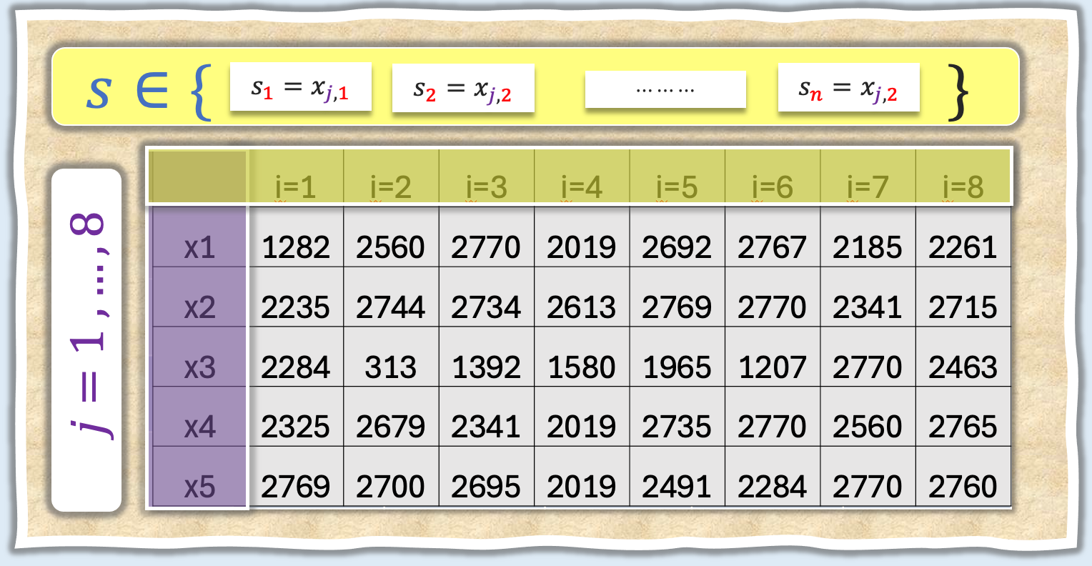
 | i=1 | i=2 | i=3 | i=4 | i=5 | i=6 | i=7 | i=8
y | 41 | 4 | 21 | 45 | 1 | 0 | 40 | 3
x1 | 86 | 60 | 53 | 93 | 67 | 59 | 66 | 76
x2 | 199 | 196 | 179 | 176 | 175 | 160 | 164 | 188
x3 | 27 | 42 | 49 | 29 | 53 | 52 | 24 | 56
x4 | 132 | 117 | 102 | 150 | 141 | 101 | 105 | 114
x5 | 506 | 537 | 528 | 540 | 521 | 505 | 504 | 523

Slide 7

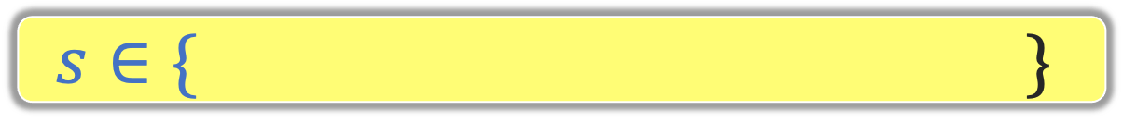
$$s∈\{ \}$$
$$s_{1}=x_{j,1}$$
$$s_{2}=x_{j,2}$$
$$⋯⋯⋯$$
$$s_{n}=x_{j,2}$$
 | i=1 | i=2 | i=3 | i=4 | i=5 | i=6 | i=7 | i=8
x1 | 1282 | 2560 | 2770 | 2019 | 2692 | 2767 | 2185 | 2261
x2 | 2235 | 2744 | 2734 | 2613 | 2769 | 2770 | 2341 | 2715
x3 | 2284 | 313 | 1392 | 1580 | 1965 | 1207 | 2770 | 2463
x4 | 2325 | 2679 | 2341 | 2019 | 2735 | 2770 | 2560 | 2765
x5 | 2769 | 2700 | 2695 | 2019 | 2491 | 2284 | 2770 | 2760
$j=1 , …, 8$

Slide 8
$$s∈\{ \}$$
$$s_{1}=x_{j,1}$$
$$s_{2}=x_{j,2}$$
$$⋯⋯⋯$$
$$s_{n}=x_{j,2}$$
 | i=1 | i=2 | i=3 | i=4 | i=5
x1 | 225 | 299 | 251 | 10 | 289
x2 | 295 | 205 | 257 | 299 | 281
x3 | 299 | 295 | 251 | 149 | 289
x4 | 262 | 257 | 270 | 299 | 225
x5 | 295 | 149 | 257 | 299 | 205
$j=1 , …, 8$

Slide 9
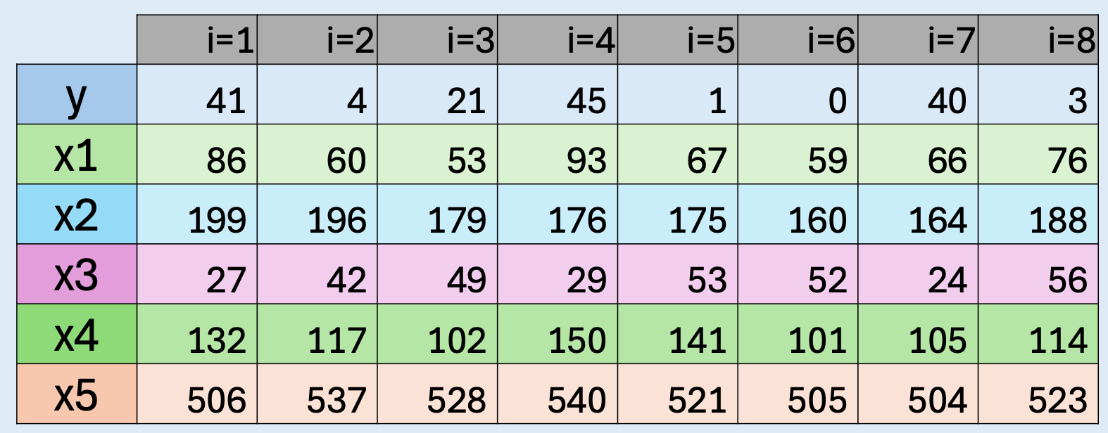


$$<$$
YES
NO

Slide 10
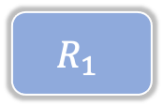

$$<$$
$$X_{3}$$
42
YES
NO
 | i=1 | i=2 | i=3
y | 41 | 45 | 40
x1 | 86 | 93 | 66
x2 | 199 | 176 | 164
x3 | 27 | 29 | 24
x4 | 132 | 150 | 105
x5 | 506 | 540 | 504
 | i=1 | i=2 | i=3 | i=4 | i=5
y | 4 | 21 | 1 | 0 | 3
x1 | 60 | 53 | 67 | 59 | 76
x2 | 196 | 179 | 175 | 160 | 188
x3 | 42 | 49 | 53 | 52 | 56
x4 | 117 | 102 | 141 | 101 | 114
x5 | 537 | 528 | 521 | 505 | 523
$$R_{1}$$

Slide 11
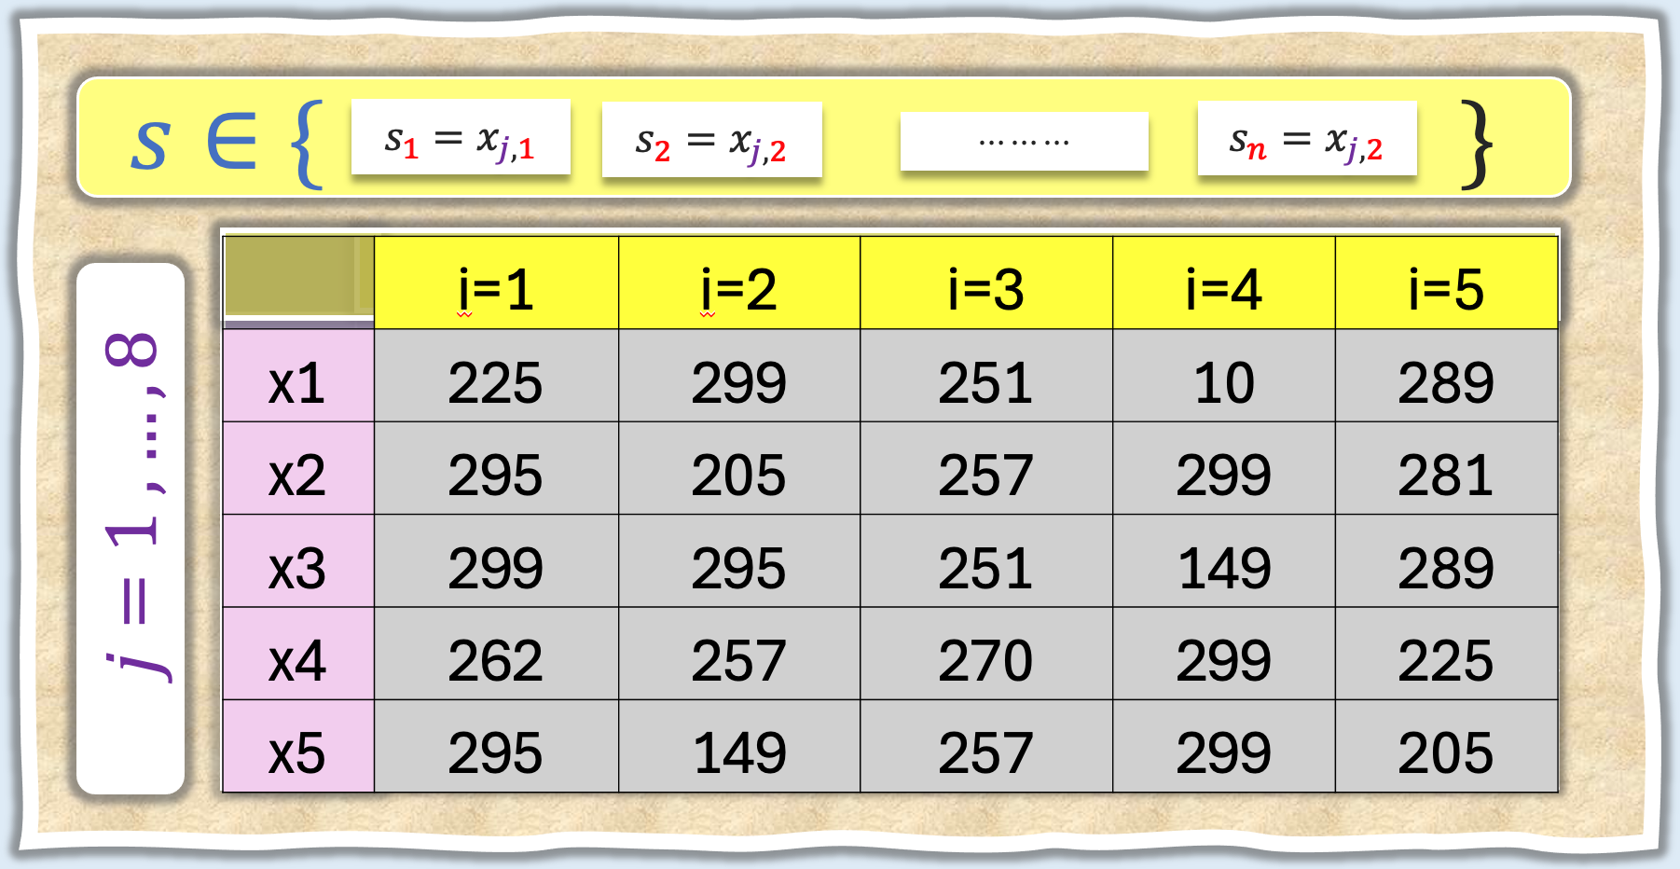





$$<$$
$$X_{3}$$
42
YES
NO
 | i=1 | i=2 | i=3
y | 41 | 45 | 40
x1 | 86 | 93 | 66
x2 | 199 | 176 | 164
x3 | 27 | 29 | 24
x4 | 132 | 150 | 105
x5 | 506 | 540 | 504
 | i=1 | i=2 | i=3 | i=4 | i=5
y | 4 | 21 | 1 | 0 | 3
x1 | 60 | 53 | 67 | 59 | 76
x2 | 196 | 179 | 175 | 160 | 188
x3 | 42 | 49 | 53 | 52 | 56
x4 | 117 | 102 | 141 | 101 | 114
x5 | 537 | 528 | 521 | 505 | 523
$$R_{1}$$
$$<$$
$$X_{1}$$
$$59$$
YES
NO
$$R_{2}$$
$$R_{3}$$

Slide 12
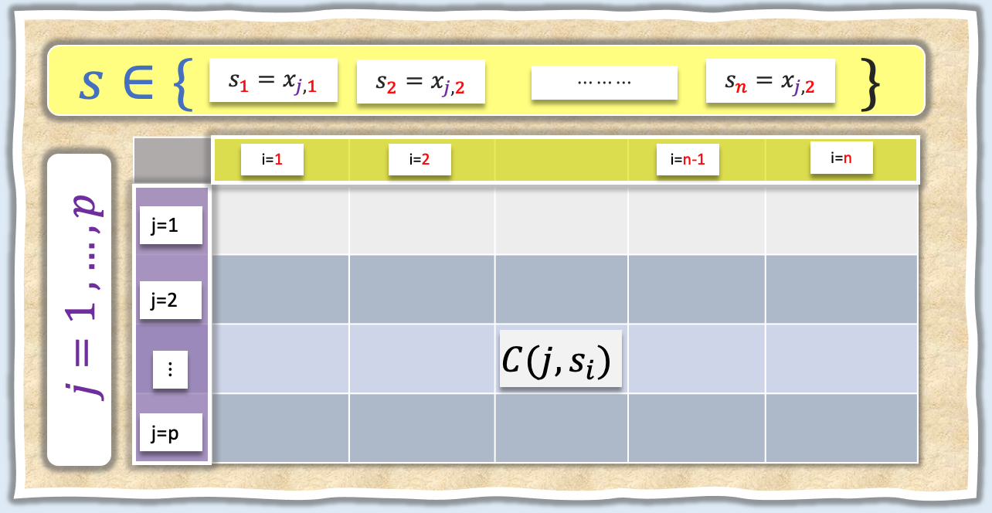













$$<$$
$$X_{2}$$
$$S_{4,1}$$
YES
NO
$$<$$
$$<$$
$$X_{1}$$
$$S_{1,5}$$
$$X_{1}$$
$$S_{1,5}$$
YES
NO
YES
NO
$$R_{1}$$
$$R_{2}$$
$$R_{3}$$
$$R_{4}$$

Slide 13

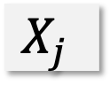



$R_{1}$
$R_{2}$
$$1$$
$$0$$
$$X_{j}$$

Slide 14
$R_{1}$
$R_{2}$
$$1$$
$$0$$
$$X_{j}$$

Slide 15
R1
R2
Y
X

Slide 29
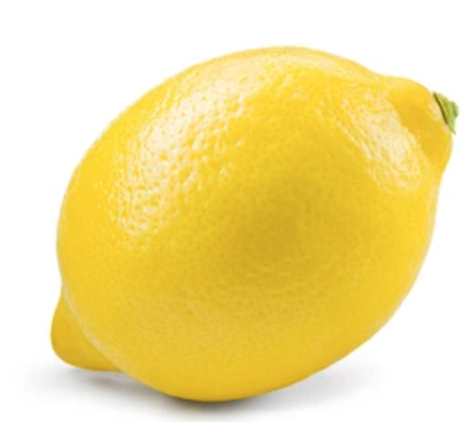
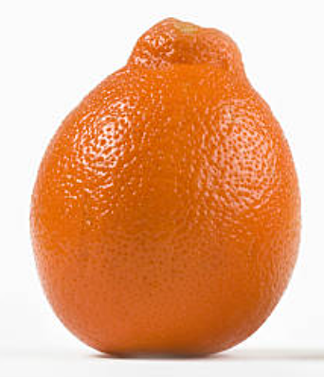
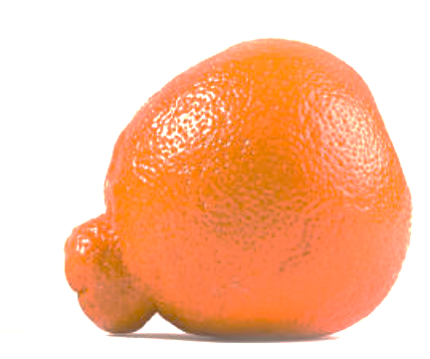
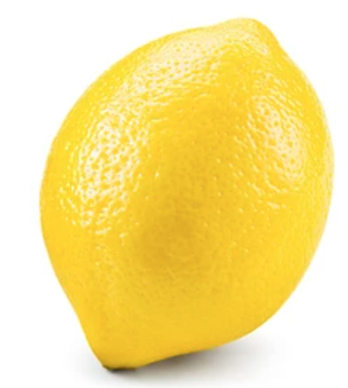
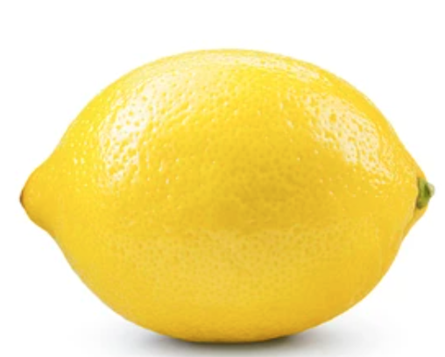
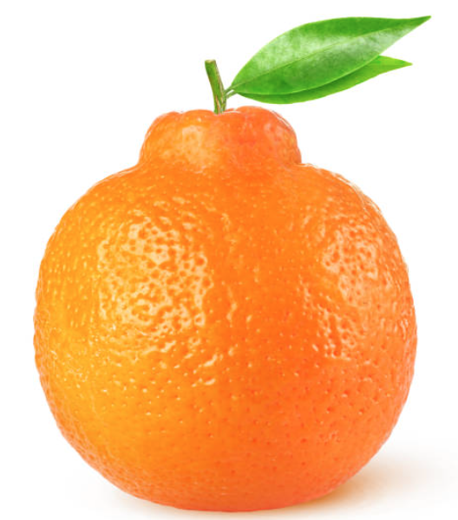
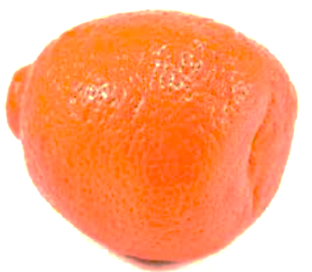
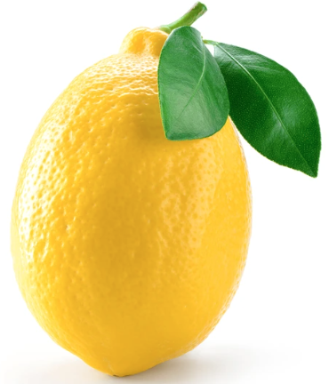
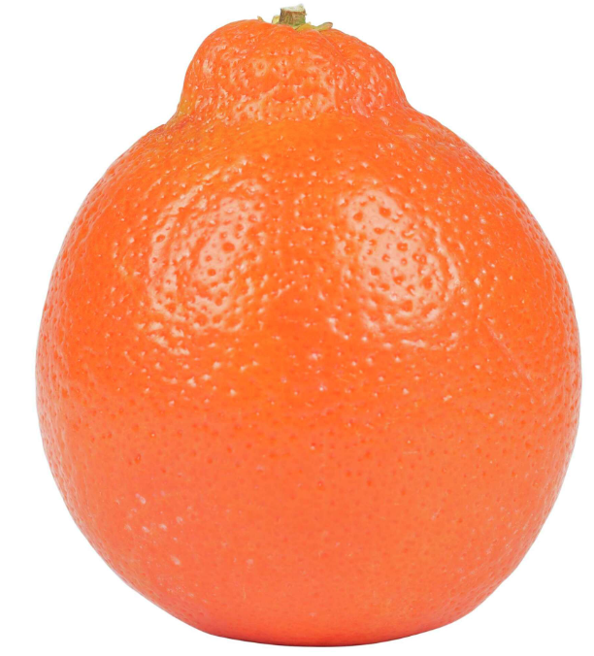
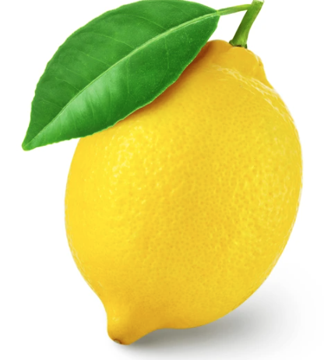
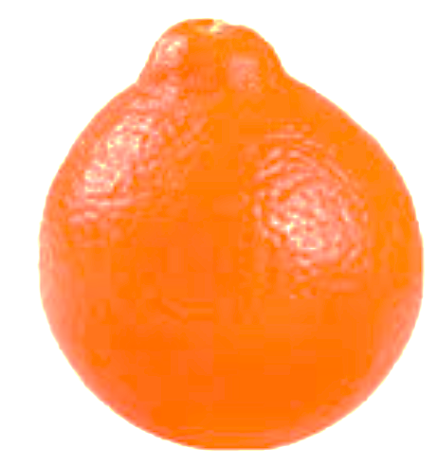
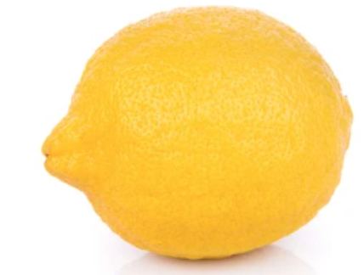
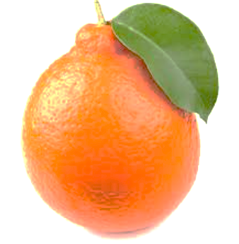

Slide 30
Width
Height
4.9
6.4
6.8
7.5
7.2
7.9
7.2
7.9
6.9
7.2
5.9
7.8
6.8
7.0
7.7
8.2
7.1
7.4
6.4
8.1
6.3
7.8
5.9
7.2
7.8
9.1

Slide 32
Case 1
Case 2

Slide 34
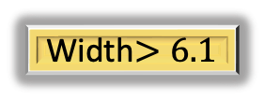

Width$≤6.1$
Width$>6.1$

Slide 35


X$≤s$
X$>s$
Category1
Category2

Slide 36


Height$≤8.5$
Height $>8.5$

Slide 37
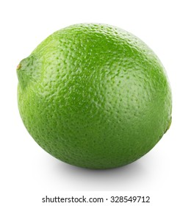
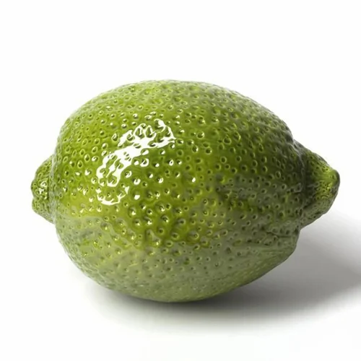
Height$≤8.5$
Height $>8.5$

Slide 38
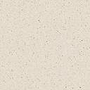
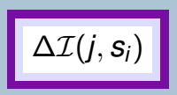
$$s∈\{ \}$$
$$s_{1}=x_{j,1}$$
$$s_{2}=x_{j,2}$$
$$⋯⋯⋯$$
$$s_{n}=x_{j,2}$$
i=1
i=2
i=n-1
i=n
j=1
$j=1 , …, p$
j=2
$$⋮$$
j=p

Slide 39
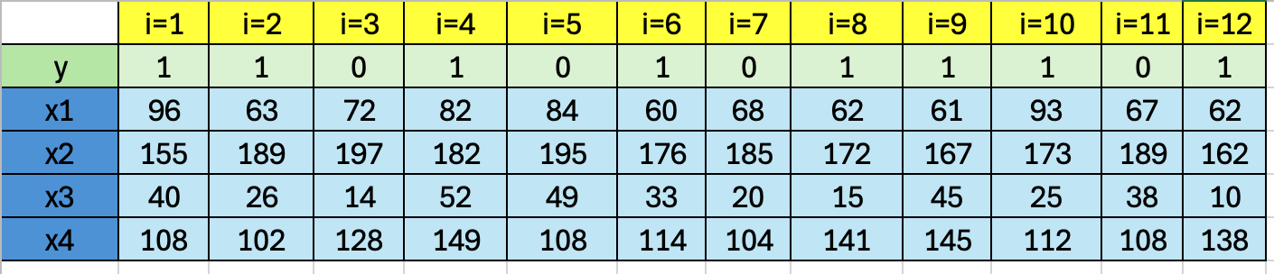
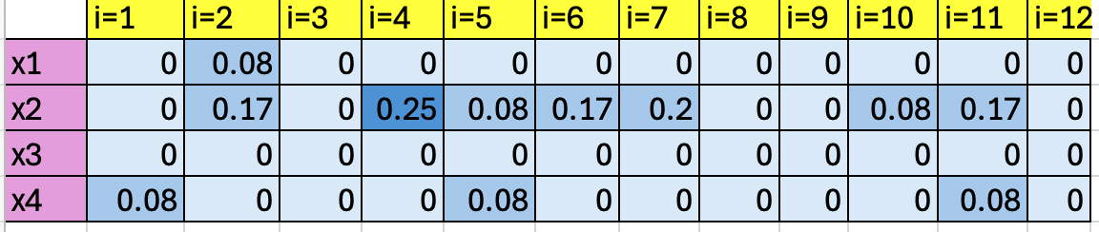





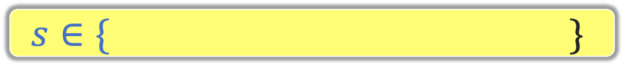

$$s∈\{ \}$$
$$s_{1}=x_{j,1}$$
$$s_{2}=x_{j,2}$$
$$⋯⋯⋯$$
$$s_{n}=x_{j,2}$$
i=1
i=2
i=n-1
i=n
j=1
$j=1 , …, p$
j=2
$$⋮$$
j=p

Slide 40
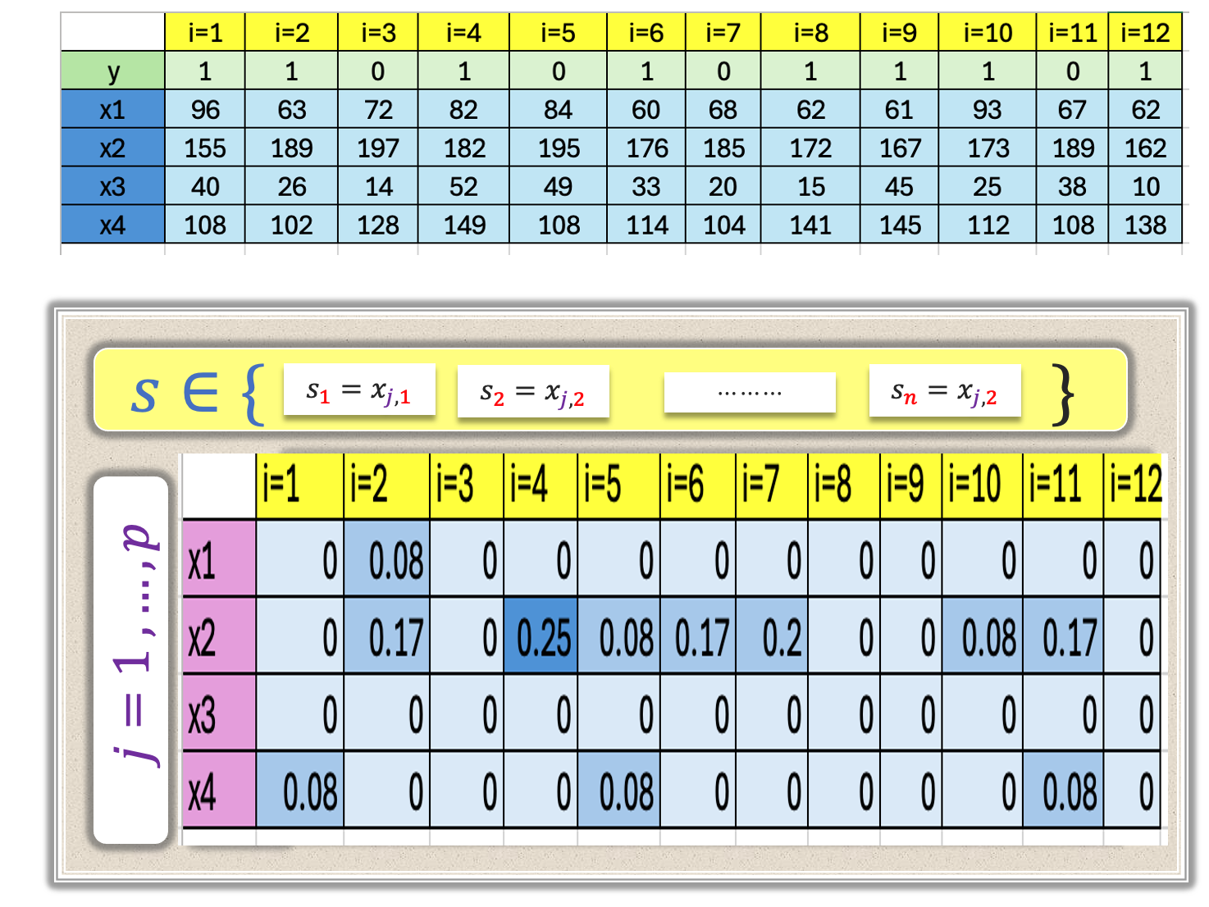
$$<$$
YES
NO

Slide 41


$$<$$
$$X_{2}$$
182
YES
NO
 | i=1 | i=2 | i=3 | i=4 | i=5 | i=6 | i=7
y | 1 | 1 | 1 | 1 | 1 | 1 | 1
x1 | 96 | 82 | 60 | 62 | 61 | 93 | 62
x2 | 155 | 182 | 176 | 172 | 167 | 173 | 162
x3 | 40 | 52 | 33 | 15 | 45 | 25 | 10
x4 | 108 | 149 | 114 | 141 | 145 | 112 | 138
 | i=1 | i=2 | i=3 | i=4 | i=5
y | 1 | 0 | 0 | 0 | 0
x1 | 63 | 72 | 84 | 68 | 67
x2 | 189 | 197 | 195 | 185 | 189
x3 | 26 | 14 | 49 | 20 | 38
x4 | 102 | 128 | 108 | 104 | 108
$$R_{1}$$

Slide 42


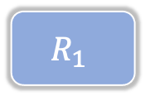



$$≤$$
$$X_{2}$$
182
YES
NO
 | i=1 | i=2 | i=3 | i=4 | i=5 | i=6 | i=7
y | 1 | 1 | 1 | 1 | 1 | 1 | 1
x1 | 96 | 82 | 60 | 62 | 61 | 93 | 62
x2 | 155 | 182 | 176 | 172 | 167 | 173 | 162
x3 | 40 | 52 | 33 | 15 | 45 | 25 | 10
x4 | 108 | 149 | 114 | 141 | 145 | 112 | 138
 | i=1 | i=2 | i=3 | i=4 | i=5
y | 1 | 0 | 0 | 0 | 0
x1 | 63 | 72 | 84 | 68 | 67
x2 | 189 | 197 | 195 | 185 | 189
x3 | 26 | 14 | 49 | 20 | 38
x4 | 102 | 128 | 108 | 104 | 108
$$R_{1}$$
 | i=1 | i=2 | i=3 | i=4 | i=5
x1 | 0.17 | 0 | 0 | 0 | 0
x2 | 0 | 0 | 0 | 0 | 0
x3 | 0 | 0 | 0 | 0 | 0
x4 | 0.2 | 0 | 0 | 0 | 0
$$≤$$
$$X_{4}$$
$$102$$
YES
NO
$$R_{2}$$
$$R_{3}$$

Slide 43
$$≤$$
$$X_{2}$$
182
YES
NO
 | i=1 | i=2 | i=3 | i=4 | i=5 | i=6 | i=7
y | 1 | 1 | 1 | 1 | 1 | 1 | 1
x1 | 96 | 82 | 60 | 62 | 61 | 93 | 62
x2 | 155 | 182 | 176 | 172 | 167 | 173 | 162
x3 | 40 | 52 | 33 | 15 | 45 | 25 | 10
x4 | 108 | 149 | 114 | 141 | 145 | 112 | 138
 | i=1 | i=2 | i=3 | i=4 | i=5
y | 1 | 0 | 0 | 0 | 0
x1 | 63 | 72 | 84 | 68 | 67
x2 | 189 | 197 | 195 | 185 | 189
x3 | 26 | 14 | 49 | 20 | 38
x4 | 102 | 128 | 108 | 104 | 108
$$R_{1}$$
 | i=1 | i=2 | i=3 | i=4 | i=5
x1 | 0.17 | 0 | 0 | 0 | 0
x2 | 0 | 0 | 0 | 0 | 0
x3 | 0 | 0 | 0 | 0 | 0
x4 | 0.2 | 0 | 0 | 0 | 0
$$≤$$
YES
NO
$$R_{2}$$
$$R_{3}$$

Slide 44
$$<$$
$$X_{3}$$
42
YES
NO
 | i=1 | i=2 | i=3
y | 41 | 45 | 40
x1 | 86 | 93 | 66
x2 | 199 | 176 | 164
x3 | 27 | 29 | 24
x4 | 132 | 150 | 105
x5 | 506 | 540 | 504
 | i=1 | i=2 | i=3 | i=4 | i=5
y | 4 | 21 | 1 | 0 | 3
x1 | 60 | 53 | 67 | 59 | 76
x2 | 196 | 179 | 175 | 160 | 188
x3 | 42 | 49 | 53 | 52 | 56
x4 | 117 | 102 | 141 | 101 | 114
x5 | 537 | 528 | 521 | 505 | 523
$$R_{1}$$
$$<$$
$$X_{1}$$
$$59$$
YES
NO
$$R_{2}$$
$$R_{3}$$

Slide 46
 | i=1 | i=2 | i=3 | i=4 | i=5 | i=6 | i=7 | i=8
y | 41 | 4 | 21 | 45 | 1 | 0 | 40 | 3
x1 | 86 | 60 | 53 | 93 | 67 | 59 | 66 | 76
x2 | 199 | 196 | 179 | 176 | 175 | 160 | 164 | 188
x3 | 27 | 42 | 49 | 29 | 53 | 52 | 24 | 56
x4 | 132 | 117 | 102 | 150 | 141 | 101 | 105 | 114
x5 | 506 | 537 | 528 | 540 | 521 | 505 | 504 | 523

Slide 47
$$s∈\{ \}$$
$$s_{1}=x_{j,1}$$
$$s_{2}=x_{j,2}$$
$$⋯⋯⋯$$
$$s_{n}=x_{j,2}$$
 | i=1 | i=2 | i=3 | i=4 | i=5 | i=6 | i=7 | i=8
x1 | 1282 | 2560 | 2770 | 2019 | 2692 | 2767 | 2185 | 2261
x2 | 2235 | 2744 | 2734 | 2613 | 2769 | 2770 | 2341 | 2715
x3 | 2284 | 313 | 1392 | 1580 | 1965 | 1207 | 2770 | 2463
x4 | 2325 | 2679 | 2341 | 2019 | 2735 | 2770 | 2560 | 2765
x5 | 2769 | 2700 | 2695 | 2019 | 2491 | 2284 | 2770 | 2760
$j=1 , …, 8$

Slide 48
$$s∈\{ \}$$
$$s_{1}=x_{j,1}$$
$$s_{2}=x_{j,2}$$
$$⋯⋯⋯$$
$$s_{n}=x_{j,2}$$
 | i=1 | i=2 | i=3 | i=4 | i=5
x1 | 225 | 299 | 251 | 10 | 289
x2 | 295 | 205 | 257 | 299 | 281
x3 | 299 | 295 | 251 | 149 | 289
x4 | 262 | 257 | 270 | 299 | 225
x5 | 295 | 149 | 257 | 299 | 205
$j=1 , …, 8$

Slide 49
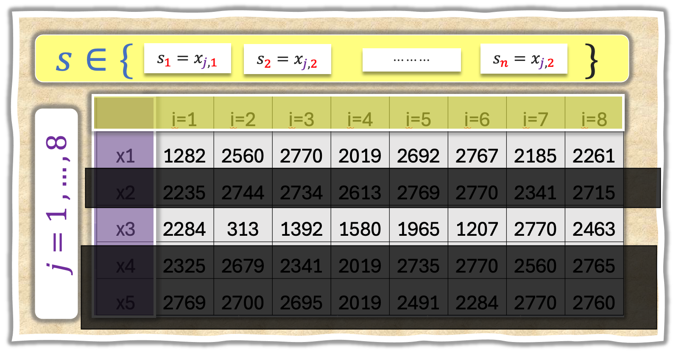
$$<$$
YES
NO

Slide 50
$$<$$
$$X_{3}$$
42
YES
NO
 | i=1 | i=2 | i=3
y | 41 | 45 | 40
x1 | 86 | 93 | 66
x2 | 199 | 176 | 164
x3 | 27 | 29 | 24
x4 | 132 | 150 | 105
x5 | 506 | 540 | 504
 | i=1 | i=2 | i=3 | i=4 | i=5
y | 4 | 21 | 1 | 0 | 3
x1 | 60 | 53 | 67 | 59 | 76
x2 | 196 | 179 | 175 | 160 | 188
x3 | 42 | 49 | 53 | 52 | 56
x4 | 117 | 102 | 141 | 101 | 114
x5 | 537 | 528 | 521 | 505 | 523
$$R_{1}$$

Slide 51
$$<$$
$$X_{3}$$
42
YES
NO
 | i=1 | i=2 | i=3
y | 41 | 45 | 40
x1 | 86 | 93 | 66
x2 | 199 | 176 | 164
x3 | 27 | 29 | 24
x4 | 132 | 150 | 105
x5 | 506 | 540 | 504
 | i=1 | i=2 | i=3 | i=4 | i=5
y | 4 | 21 | 1 | 0 | 3
x1 | 60 | 53 | 67 | 59 | 76
x2 | 196 | 179 | 175 | 160 | 188
x3 | 42 | 49 | 53 | 52 | 56
x4 | 117 | 102 | 141 | 101 | 114
x5 | 537 | 528 | 521 | 505 | 523
$$R_{1}$$
$$<$$
YES
NO
$$R_{2}$$
$$R_{3}$$

Slide 52
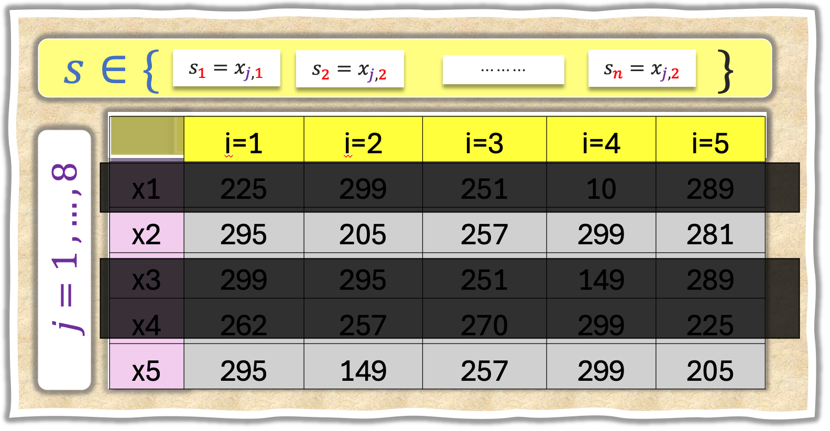
$$<$$
$$X_{3}$$
42
YES
NO
 | i=1 | i=2 | i=3
y | 41 | 45 | 40
x1 | 86 | 93 | 66
x2 | 199 | 176 | 164
x3 | 27 | 29 | 24
x4 | 132 | 150 | 105
x5 | 506 | 540 | 504
 | i=1 | i=2 | i=3 | i=4 | i=5
y | 4 | 21 | 1 | 0 | 3
x1 | 60 | 53 | 67 | 59 | 76
x2 | 196 | 179 | 175 | 160 | 188
x3 | 42 | 49 | 53 | 52 | 56
x4 | 117 | 102 | 141 | 101 | 114
x5 | 537 | 528 | 521 | 505 | 523
$$R_{1}$$
$$<$$
YES
NO
$$R_{2}$$
$$R_{3}$$

Slide 53
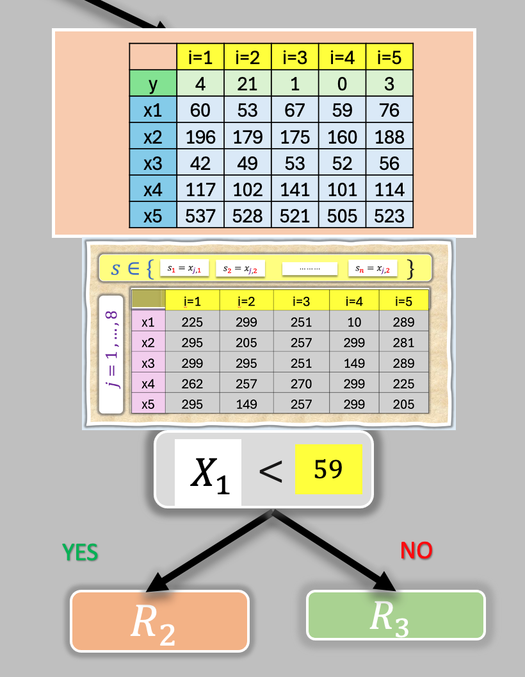
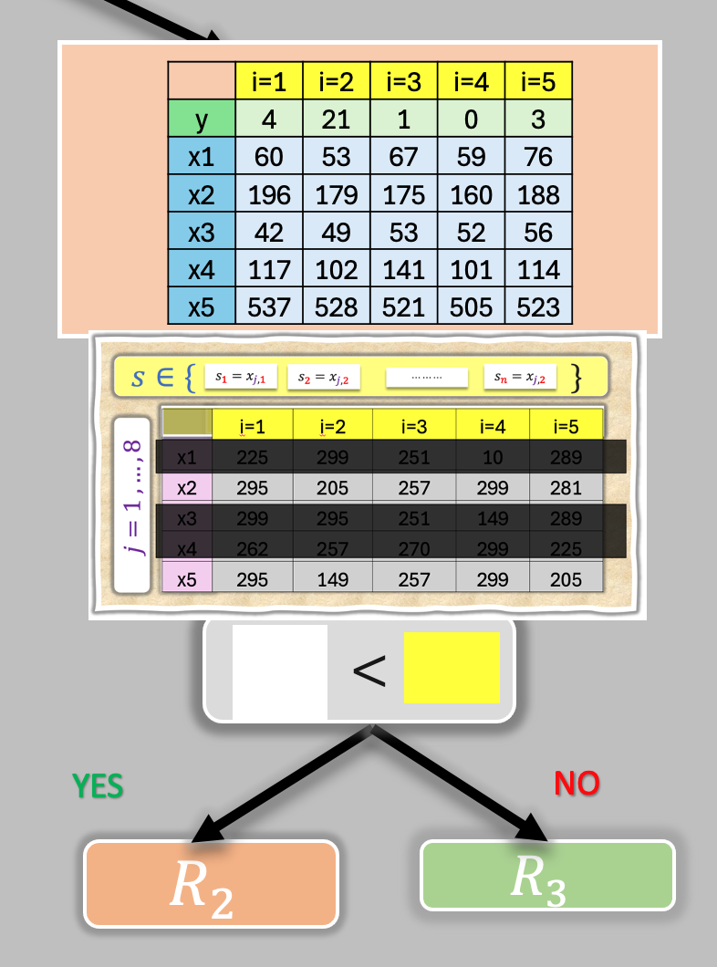

Slide 54


$$<$$
$$X_{3}$$
42
YES
NO
 | i=1 | i=2 | i=3
y | 41 | 45 | 40
x1 | 86 | 93 | 66
x2 | 199 | 176 | 164
x3 | 27 | 29 | 24
x4 | 132 | 150 | 105
x5 | 506 | 540 | 504
 | i=1 | i=2 | i=3 | i=4 | i=5
y | 4 | 21 | 1 | 0 | 3
x1 | 60 | 53 | 67 | 59 | 76
x2 | 196 | 179 | 175 | 160 | 188
x3 | 42 | 49 | 53 | 52 | 56
x4 | 117 | 102 | 141 | 101 | 114
x5 | 537 | 528 | 521 | 505 | 523
$$R_{1}$$
$$<$$
$$X_{5}$$
$$528$$
YES
NO
$$R_{2}$$
$$R_{3}$$

Slide 55

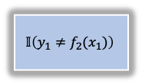


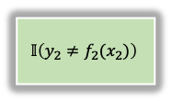
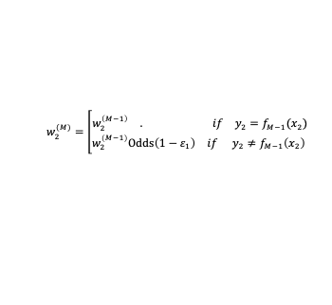

































$$i=1$$
$$i=2$$
$$i=N$$
$$w_{1}^{(1)}=1$$
$$w_{2}^{(1)}=1$$
$$w_{N}^{(1)}=1$$
$$ε_{1}=\frac{\sum_{i=1}^{N}{w_{i}^{(1)}𝕀\left(y_{i}≠f_{1}(x_{i})\right)}}{\sum_{i=1}^{N}{w_{i}^{(1)}}}$$
…
$$f_{1}$$
$$w_{1}^{(1)}$$
$$𝕀\left(y_{1}≠f_{1}(x_{1})\right)$$
$$w_{2}^{(1)}$$
$$𝕀\left(y_{2}≠f_{1}(x_{2})\right)$$
$$w_{N}^{(1)}$$
$$𝕀\left(y_{N}≠f_{1}(x_{N})\right)$$
$$α_{1}=\log\left(\frac{{1− ε}_{1}}{ε_{1}}\right)$$
$$w_{1}^{(2)}=\left[\begin{matrix}\begin{matrix}w_{1}^{\left(1\right)} & . if & y_{1}=f_{1}(x_{1}\end{matrix} \\ \begin{matrix}w_{1}^{\left(1\right)}Odds\left(1−ε_{1}\right) & if & y_{1}≠f_{1}\left(x_{1}\right)\end{matrix} \end{matrix}\right.$$
$$w_{2}^{(2)}=\left[\begin{matrix}\begin{matrix}w_{2}^{\left(1\right)} & . if & y_{2}=f_{1}(x_{2})\end{matrix} \\ \begin{matrix}w_{2}^{\left(1\right)}Odds\left(1−ε_{1}\right) & if & y_{2}≠f_{1}\left(x_{2}\right)\end{matrix} \end{matrix}\right.$$
$$w_{N}^{(2)}=\left[\begin{matrix}\begin{matrix}w_{N}^{\left(1\right)} & . if & y_{N}=f_{1}(x_{N})\end{matrix} \\ \begin{matrix}w_{N}^{\left(1\right)}Odds\left(1−ε_{1}\right) & if & y_{N}≠f_{1}\left(x_{N}\right)\end{matrix} \end{matrix}\right.$$
$$ε_{2}=\frac{\sum_{i=1}^{N}{w_{i}^{(2)}𝕀\left(y_{i}≠f_{2}(x_{i})\right)}}{\sum_{i=1}^{N}{w_{i}^{(2)}}}$$
…
$$f_{2}$$
$$w_{1}^{(2)}$$
$$𝕀\left(y_{1}≠f_{2}(x_{1})\right)$$
$$w_{2}^{(2)}$$
$$𝕀\left(y_{2}≠f_{2}(x_{2})\right)$$
$$w_{N}^{(2)}$$
$$𝕀\left(y_{N}≠f_{2}(x_{N})\right)$$
$$α_{2}=\log\left(\frac{{1− ε}_{2}}{ε_{2}}\right)$$
…
…
…
…
…
…
$$w_{1}^{(M)}=\left[\begin{matrix}\begin{matrix}w_{1}^{\left(M−1\right)} & . if & y_{1}=f_{M−1}(x_{1})\end{matrix} \\ \begin{matrix}w_{1}^{\left(M−1\right)}Odds\left(1−ε_{M−1}\right) & if & y_{1}≠f_{M−1}\left(x_{1}\right)\end{matrix} \end{matrix}\right.$$
$$w_{2}^{(M)}=\left[\begin{matrix}\begin{matrix}w_{2}^{\left(M−1\right)} & . if & y_{2}=f_{M−1}(x_{2})\end{matrix} \\ \begin{matrix}w_{2}^{\left(M−1\right)}Odds\left(1−ε_{1}\right) & if & y_{2}≠f_{M−1}\left(x_{2}\right)\end{matrix} \end{matrix}\right.$$
$$w_{N}^{(M)}=\left[\begin{matrix}\begin{matrix}w_{N}^{\left(M−1\right)} & . if & y_{N}=f_{M−1}(x_{N})\end{matrix} \\ \begin{matrix}w_{N}^{\left(M−1\right)}Odds\left(1−ε_{1}\right) & if & y_{N}≠f_{M−1}\left(x_{N}\right)\end{matrix} \end{matrix}\right.$$
$$ε_{M}=\frac{\sum_{i=1}^{N}{w_{i}^{(M)}𝕀\left(y_{i}≠f_{M}(x_{i})\right)}}{\sum_{i=1}^{N}{w_{i}^{(M)}}}$$
…
$$f_{M}$$
$$w_{1}^{(M)}$$
$$𝕀\left(y_{1}≠f_{M}(x_{1})\right)$$
$$w_{2}^{(M)}$$
$$𝕀\left(y_{2}≠f_{M}(x_{2})\right)$$
$$w_{N}^{(M)}$$
$$𝕀\left(y_{N}≠f_{M}(x_{N})\right)$$
$$α_{M}=\log\left(\frac{{1− ε}_{M}}{ε_{M}}\right)$$

Slide 56








$$f_{1}$$
$$α_{1}=\log\left(\frac{{1− ε}_{1}}{ε_{1}}\right)$$
$$f_{2}$$
$$α_{2}=\log\left(\frac{{1− ε}_{2}}{ε_{2}}\right)$$
$$α_{M}=\log\left(\frac{{1− ε}_{M}}{ε_{M}}\right)$$
$$f_{M}$$
$${\hat{f}}_{boost}\left(x\right)=sign \left(\sum_{m=1}^{M}{α_{m}f_{m}\left(x\right)}\right)$$

Slide 58



